Slide 1


Precipitation prediction （NOAA JFK STATION) Project 4 Machine learning Group Member Names: Daniel Marquez, Peiran (Diana) Cao ,Lailah Libay University of Toronto – data analytics

Slide 2

About the project
Predictive precipitation modelling of weather patterns using NOAA station data (JFK)
Select monthly data from 2010-2022
Variables select wind, precipitation, temperature, pressure, fog, thunderstorms
Supervise Machine learning Model: Regression, linear model, means square
Visualization: Tableau
Notes:
Why we selected monthly data
Reduced dimensionality: Daily weather data can be quite granular and result in a large number of features. This high dimensionality can lead to increased complexity and computational requirements for training models. By aggregating the data into monthly intervals, you can significantly reduce the number of features, making it easier to analyze and model.
Smoothing and generalization: Daily weather data often includes fluctuations and noise due to short-term variations, such as daily weather patterns or measurement errors. Aggregating the data to a monthly level can help smooth out these fluctuations, providing a more generalized view of the weather patterns over time. This can improve the overall stability and robustness of your models.
Enhanced interpretability: Monthly data can offer a clearer understanding of long-term climate trends and patterns. By analyzing monthly weather data, you can identify seasonal variations, climate changes, or trends that may not be as evident in daily data. This can provide valuable insights and help make more informed decisions.
Data availability and consistency: In some cases, obtaining reliable and consistent daily weather data for a long period can be challenging. Quality control issues, missing data, or variations in data sources can introduce inconsistencies or gaps in the dataset. Monthly data, on the other hand, is generally more readily available and tends to have fewer data quality issues, making it easier to obtain and work with.
Computational efficiency: Working with monthly data reduces the computational burden associated with processing and analyzing large volumes of daily data. This can be particularly beneficial when working with limited computing resources or when dealing with large-scale datasets.

Slide 3




Slide 1
Project Stages
ETL （Extract， Transform， Load)
EDA (Exploratory Data Analysis)
Machine Learning
Visualizations

Slide 4



ETL
Transform
LOAD
EXTRACT
Data Clean
Filter
Summarize
PostgreSQL
NOAA.GOV API

Slide 5

EDA (exploratory Data analysis)
Data Collection
Data Inspection:
Data Visualization:
Feature Analysis (Calculate correlation):
Missing Data Handling:
Feature Engineering
Data Preprocessing:
Outlier Detection:
Dimensionality Reduction
Data Split:
Notes:
Using PostgreSQL, Python, and NOAA API
Data Collection:
Retrieve weather data from NOAA API
Store data in PostgreSQL database
Data Inspection:
Connect to PostgreSQL database
Check data structure and quality
Data Visualization:
Use Python libraries for visualizations
Plot time series graphs, histograms, etc.
Feature Analysis:
Explore relationships between features
Calculate correlations with target variable
Missing Data Handling:
Determine strategy for missing values
Remove or impute missing data
Feature Engineering:
Create new features from existing ones
Consider temporal features, transformations
Data Preprocessing:
Scale, normalize, one-hot encode data
Prepare data for machine learning models
Outlier Detection:
Identify and handle outliers
Use statistical or visual techniques
Data Split:
Divide data into training, validation, test sets
Train, tune, and evaluate models

Slide 6
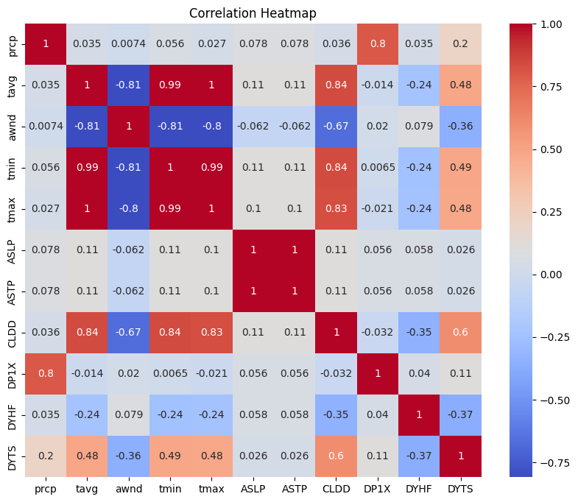
Feature Analysis (Calculate correlation):

Slide 7
Machine Learning

Slide 8
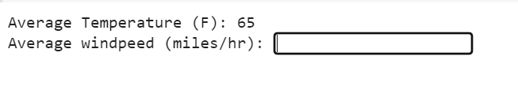
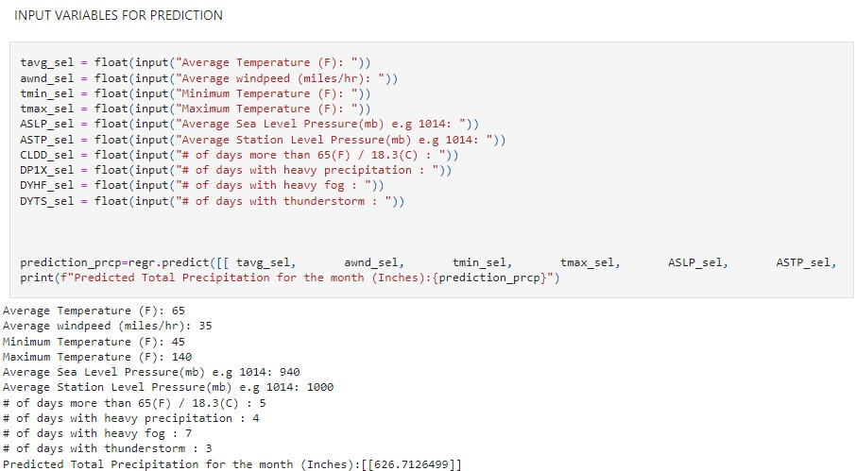
Machine Learning

Slide 9
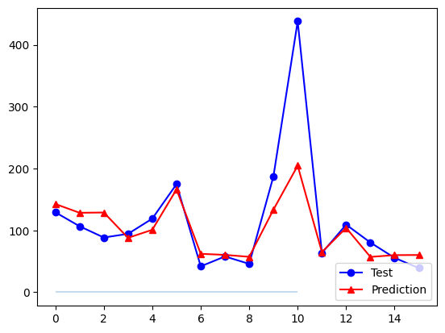
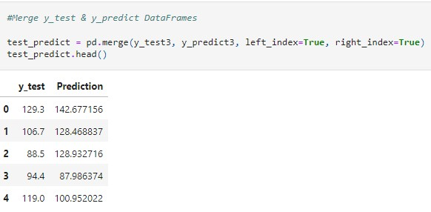
Machine Learning

Slide 10
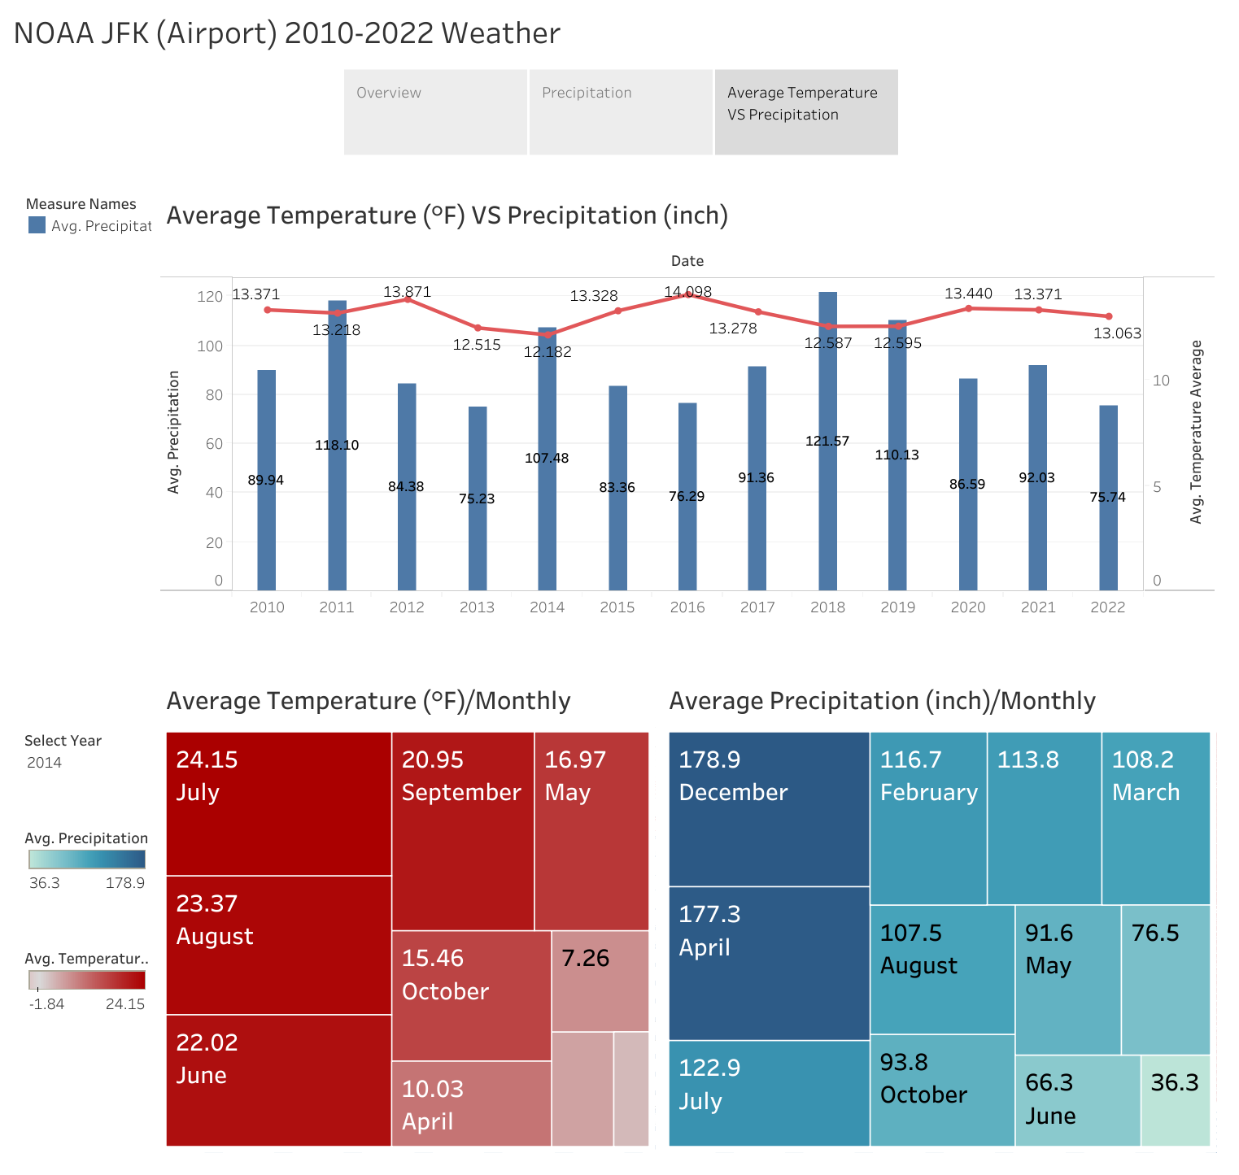
Visualizations (Tableau)

Slide 11

QUESTION TIME

Slide 12

Thank you

